Slide 1

Week 2: LLM Overview
Understanding the Architecture and Training of Large Language Models
Machine Learning Engineer in the Generative AI Era

Slide 2
Agenda
Transformer Architecture and Attention Mechanism​
Next Token Prediction and Hallucination​
LLM Pretraining​
Supervised Fine-Tuning (SFT)​
Alignment Techniques: DPO and PPO​
Data Requirements, Costs, and Challenges​
Test-Time Scaling (O1, O3)​
Hands-On Project Introduction

Slide 3
Transformer Architecture
Key Components:
Multi-Head Self-Attention​
Feedforward Neural Networks​
Positional Encoding​
Layer Normalization

Slide 4
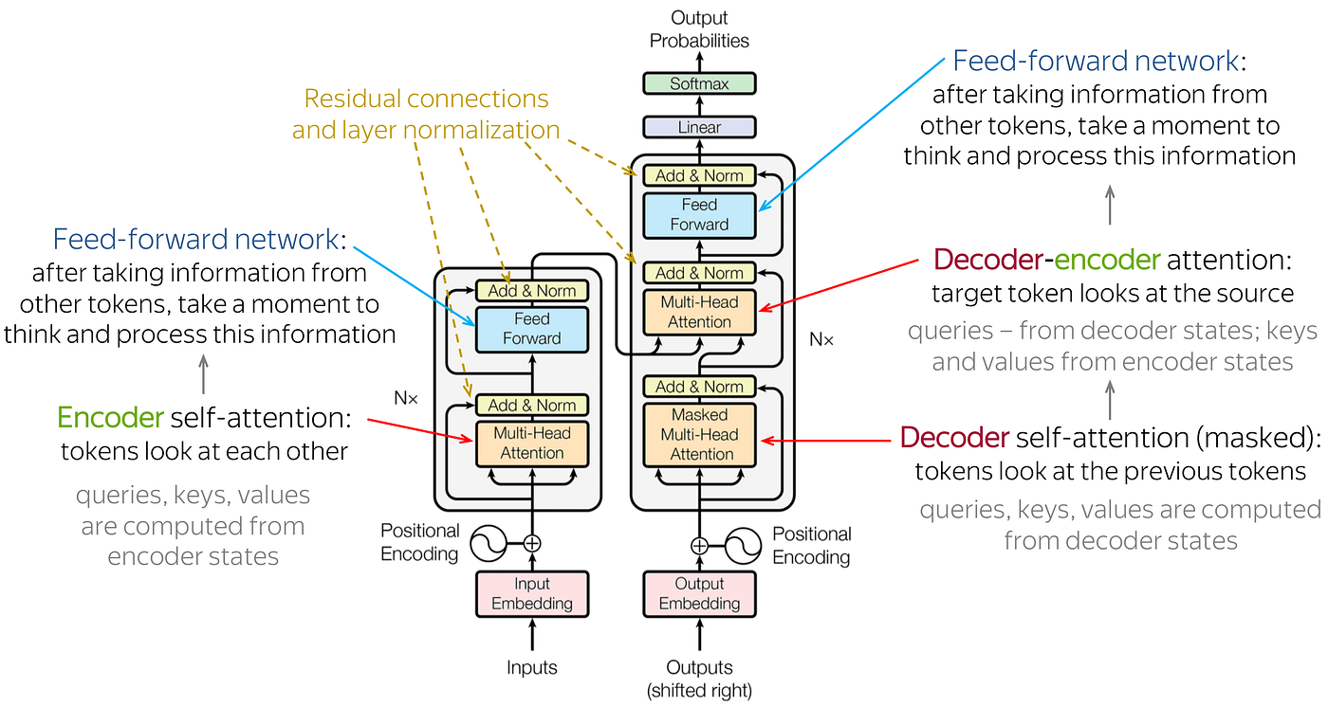
Transformer Architecture Overview
[1]
​[1] Abaskohi, Amirhossein. "Navigating Transformers: A Comprehensive Exploration of Encoder-Only and Decoder-Only Models, Right Shift, and Beyond." Medium, 16 Aug. 2023, https://medium.com/@amirhossein.abaskohi/navigating-transformers-a-comprehensive-exploration-of-encoder-only-and-decoder-only-models-right-a0b46bdf6abe.

Slide 5
Encoder-Decoder Structure
Overview:
The Transformer architecture revolutionized natural language processing by eliminating recurrence and convolutions in favor of attention mechanisms.​ [1]
The architecture comprises two main components:
the Encoder and the Decoder, both built from stacks of identical layers.
[1] Vaswani, Ashish, et al. "Attention is all you need." Advances in neural information processing systems 30 (2017).

Slide 6
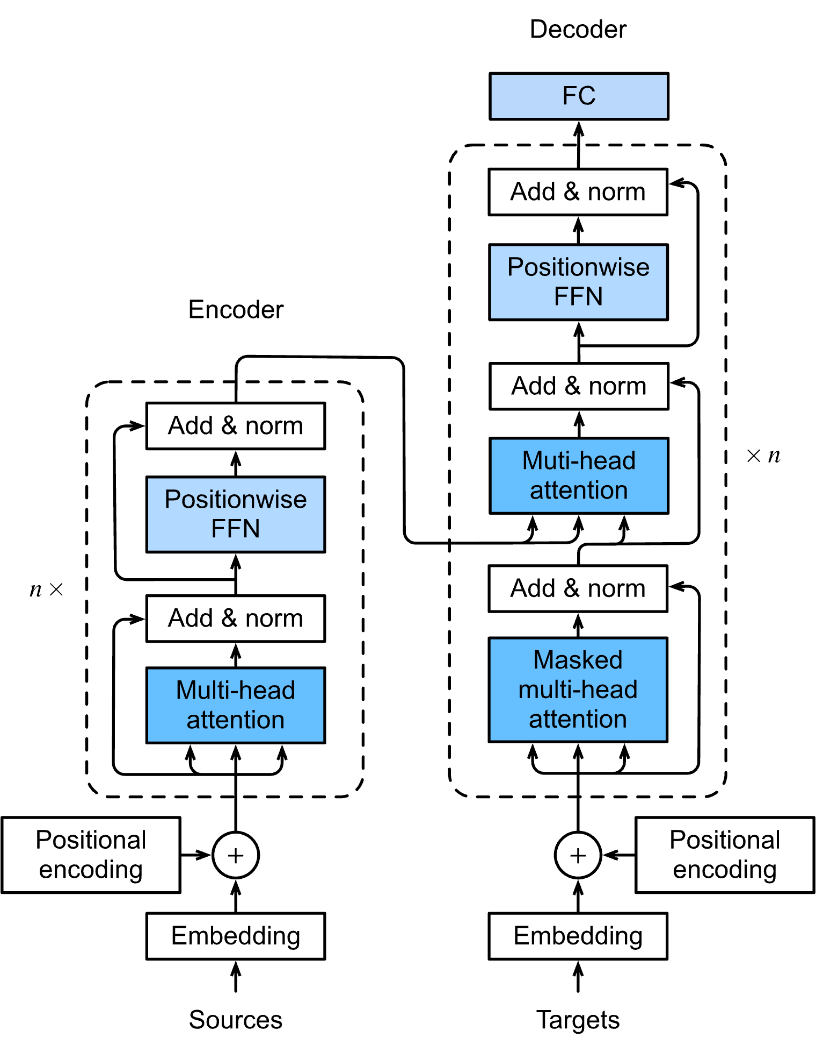
Encoder
Input Processing:
Each input token is first converted into a vector using an embedding layer.​
Positional encoding is added to these embeddings to retain the order of the sequence, as the model lacks inherent sequence-awareness.​Layer Composition:
Each encoder layer consists of:
Multi-Head Self-Attention Mechanism: Allows the model to focus on different parts of the input sequence simultaneously, capturing various relationships.
Feed-Forward Neural Network (FFN): Applies non-linear transformations to each position separately and identically.
Residual connections and layer normalization are employed after each sub-layer to facilitate training and convergence.
[1]
[1] Zhang, Aston, et al. "11.7. The Transformer Architecture." Dive into Deep Learning, 2023, https://d2l.ai/chapter_attention-mechanisms-and-transformers/transformer.html.​

Slide 7
Decoder
Input Processing:
Similar to the encoder, the decoder starts with embedding the target sequence tokens and adding positional encodings.
​Layer Composition:
Each decoder layer includes:​
Masked Multi-Head Self-Attention Mechanism: Prevents positions from attending to subsequent positions, ensuring the model predicts the next token without peeking ahead.
Encoder-Decoder Attention Mechanism: Allows the decoder to focus on relevant parts of the input sequence by attending to the encoder's output.
Feed-Forward Neural Network (FFN): Similar to the encoder's FFN, applied position-wise.
Again, residual connections and layer normalization are applied after each sub-layer.​
[1]
[1] Zhang, Aston, et al. "11.7. The Transformer Architecture." Dive into Deep Learning, 2023, https://d2l.ai/chapter_attention-mechanisms-and-transformers/transformer.html.​

Slide 8
Encoder-Decoder Key Features:
Parallelization: Unlike RNNs, Transformers process all tokens simultaneously, enabling efficient training and inference.​ [1]
Long-Range Dependency Modeling: The attention mechanisms allow the model to capture relationships between distant tokens effectively.​
Flexibility: The architecture can be adapted for various tasks by modifying the encoder, decoder, or both.
Applications:
Machine Translation (e.g., English to German)​
Text Summarization​
Question Answering​
Text Generation
[1] Hugging Face. Transformer-based Encoder-Decoder Models. Hugging Face Blog

Slide 9
Attention Mechanism
An attention mechanism is a component in deep learning models that enables the network to focus on specific parts of the input data, assigning different levels of importance to different elements. This approach enhances the model's ability to capture relevant information, especially in tasks involving sequences or spatial data. Here’s some attention mechanism
Type of the attention cover in this lecture
Self-Attention
Multi-Head Attention
Notes:
Types of Attention Mechanisms:
Self-Attention (Intra-Attention):
Enables the model to assess the relationship between different positions within the same input sequence.​
Application: Widely used in Natural Language Processing (NLP) tasks to understand context by relating words in a sentence to each other. ​arXiv
Scaled Dot-Product Attention:
Computes attention scores using the dot product of query and key vectors, scaled by the square root of the key dimension.​
Application: Fundamental in Transformer architectures for efficient computation of attention weights. ​Wikipedia
Multi-Head Attention:
Employs multiple attention heads to capture information from different representation subspaces, allowing the model to focus on various parts of the input simultaneously.​
Application: Enhances the model's ability to capture diverse features and relationships in data. ​
Additive (Bahdanau) Attention:
Calculates attention weights using a feed-forward network with non-linear activation, combining query and key vectors.​
Application: Common in sequence-to-sequence models, particularly in machine translation, to align source and target sequences. ​
Location-Based Attention:
Determines attention weights based solely on the position of elements, without relying on content-based information.​
Application: Useful in tasks where positional information is crucial, such as speech recognition. ​Spot Intelligence
Global vs. Local Attention:
Global Attention: Considers all positions in the input sequence when computing attention weights.​
Local Attention: Focuses on a specific subset or window of the input sequence.​
Application: Balances between comprehensive context understanding and computational efficiency.

Slide 10
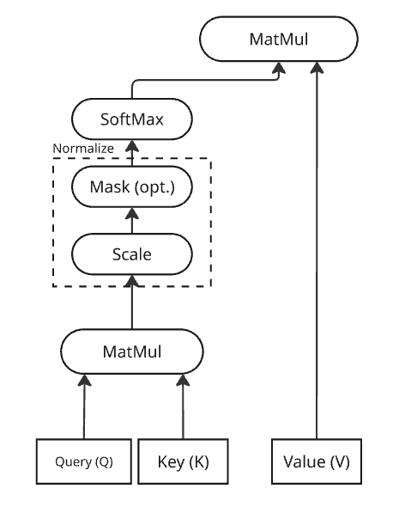
Self Attention / Scaled Dot Product attention
The scaled dot-product attention is a mechanism that Transformers use to weigh the significance of different parts of the input data. It computes attention scores based on the query (Q), key (K), and value (V) matrices derived from the input. The attention function is computed as a dot product of Q and K, scaled by the square root of the key's dimensionality, followed by a softmax function to obtain the weights on the values.
Application: Widely used in Natural Language Processing (NLP) tasks to understand context by relating words in a sentence to each other. ​
Notes:
Imagine a set of arrows (Q) looking for matching directions in another set (K). When they align well, they produce a stronger signal (dot product). This signal is 'scaled' to avoid extremely large values that could affect the softmax distribution. Each Q arrow, now with a set of weights, collects information (V) based on these weights.

Slide 11
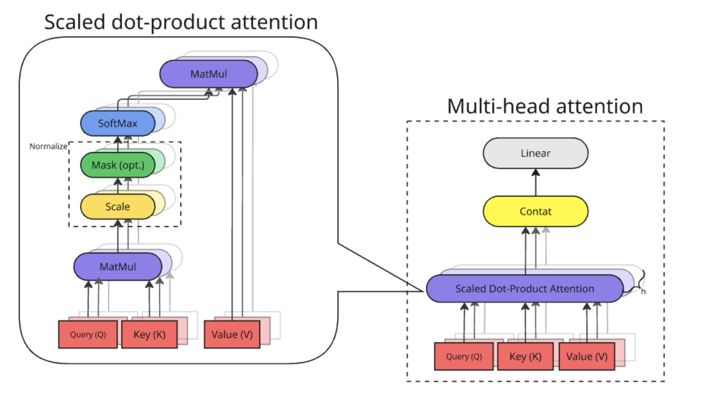
Multi-Head Attention
The Multi-Head Attention mechanism allows the model to focus on different parts of the input sequence simultaneously. By employing multiple attention "heads," the model can capture various types of relationships and dependencies within the data.
Multiple “heads” are created, each attending to the input sequence through its own Q, K, and V matrices.
Each head learns to focus on different aspects of the data, like long-range dependencies, syntactic relationships, or local word interactions.
The outputs from each head are then concatenated and projected to a final representation, capturing the multifaceted nature of the input.

Slide 12
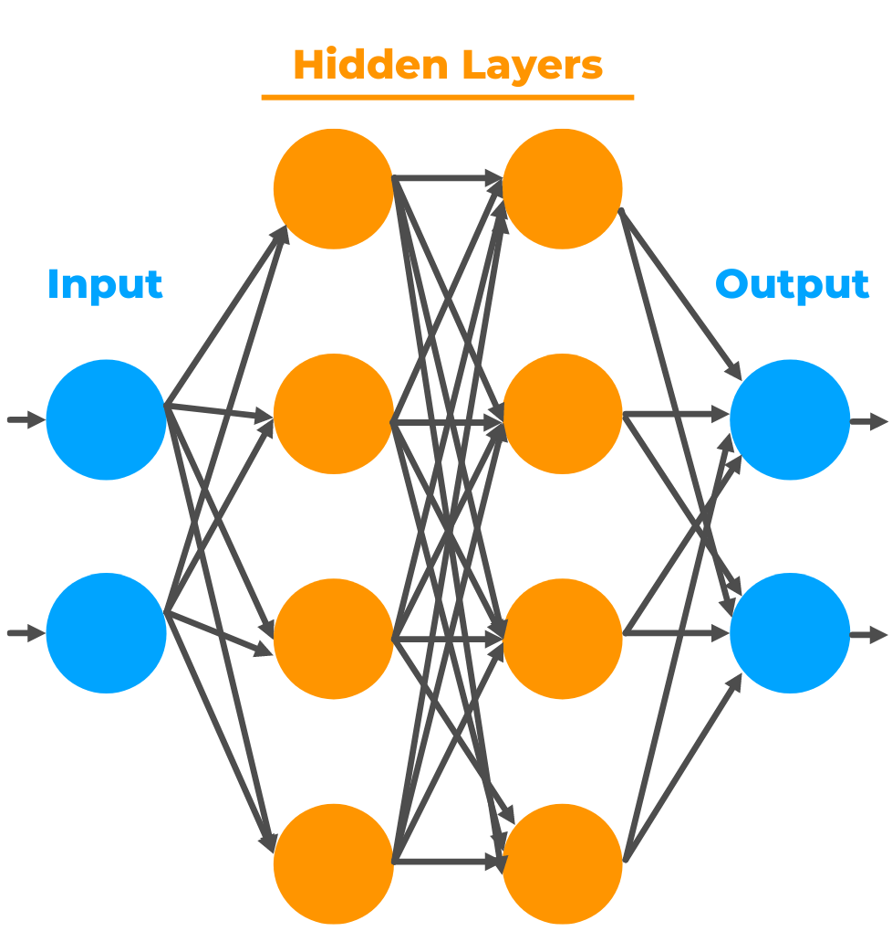
Feedforward Neural Networks​
A feedforward neural network is a type of neural network where connections between the nodes do not form a cycle. It processes inputs in one direction—forward—from input to output.
No recursion or feedback loops
Core component of the Transformer architecture
Used after attention layers to apply transformations to each token independently
Common Types of FFNNs
Standard Dense FFNN
Position-wise FFN (used in Transformers)
Residual FFN Blocks

Slide 13
Positional Encoding in Transformers
Why Positional Encoding?
Transformers lack recurrence or convolution, so they need an explicit way to understand the order of input tokens.
Helps model capture sequence order and token relationships
Added to input embeddings before feeding into the encoder
Two Main Types
Sinusoidal Positional Encoding (used in original Transformer)
Learned Positional Encoding
Positional encodings are added to token embeddings so the model can differentiate between:
“The cat sat on the mat”
“On the mat sat the cat”

Slide 14
Layer Normalization in Transformers
What is Layer Normalization? Layer Normalization (LayerNorm) stabilizes and accelerates training by normalizing the hidden states across the features of a single token.
Unlike BatchNorm (which normalizes across the batch), LayerNorm operates independently per token.
Especially important in Transformers where token positions are processed in parallel.
Where It’s Used in Transformers
Before or after Multi-Head Attention and Feedforward layers (depending on pre-norm or post-norm architecture)
Combined with residual connections to ensure gradient flow and model stability
Benefits
Faster convergence during training
Reduces internal covariate shift
Enables deeper models with residual learning

Slide 15
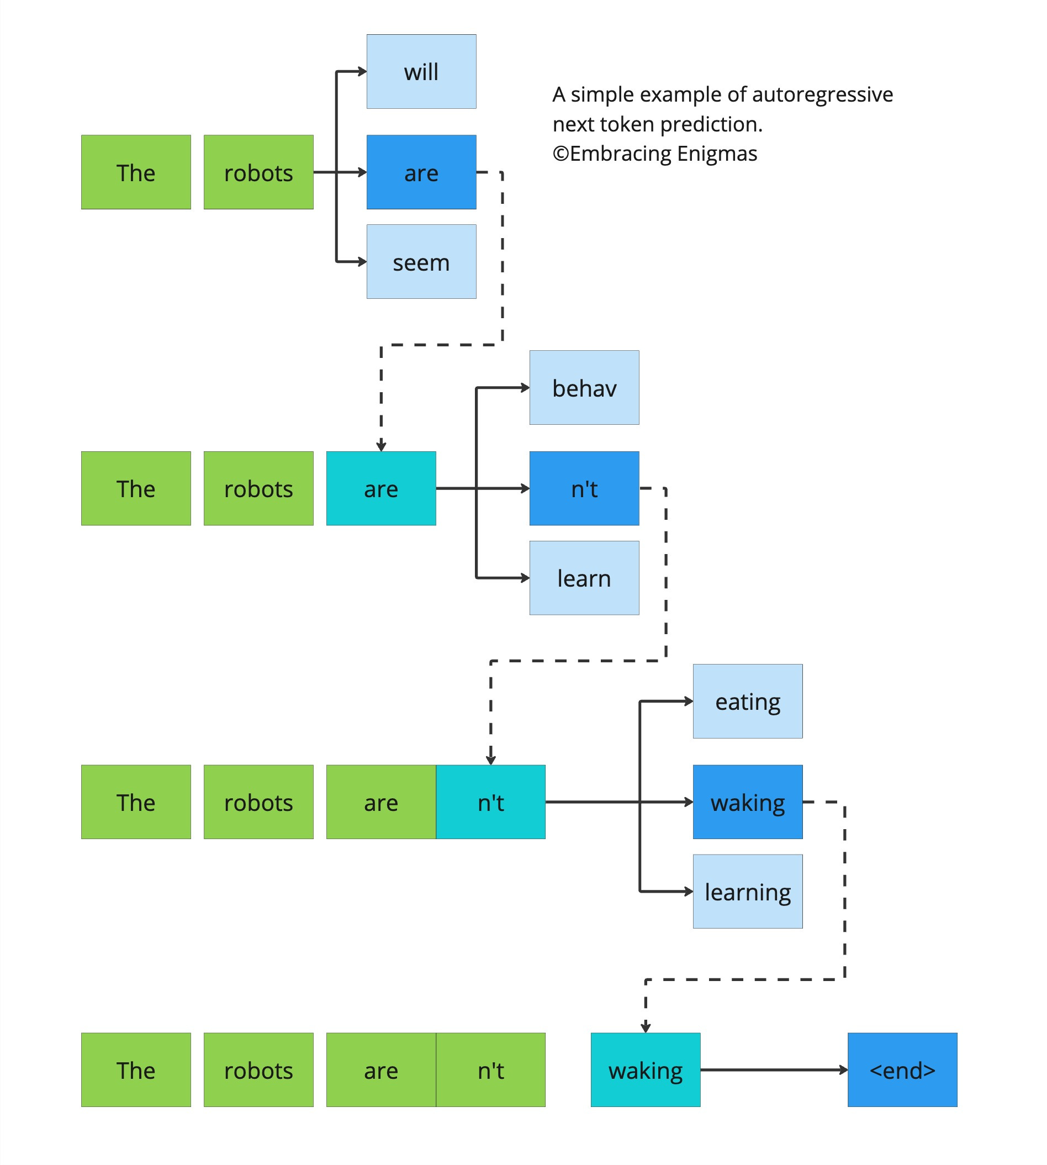
Next Token Prediction
Predict the next word in a sequence given the previous words.
Example:
Input: ”The robots aren’t"​
Model Prediction: ”walking”​
Training: Uses large corpora of text data to learn language patterns.

Slide 16
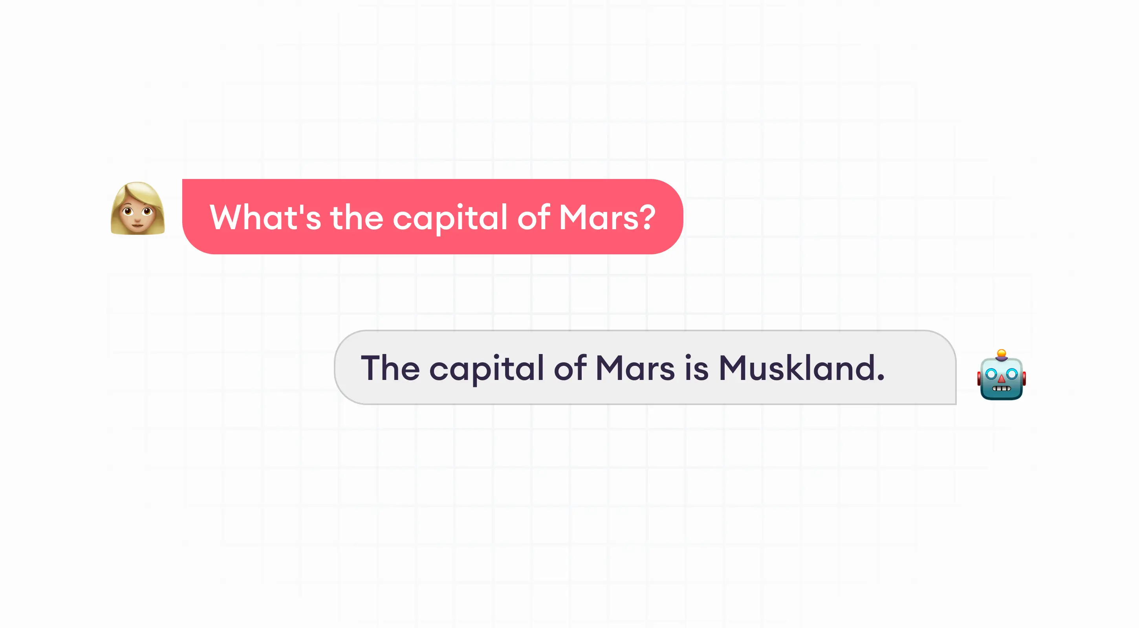
Hallucination in LLMs
Definition: Hallucination occurs when an LLM generates output that is plausible but factually incorrect or nonsensical.
🧠 Why It Happens
Lack of grounding in external factual data
Over-generalization from training data
Prompt ambiguity or under-specification
Generation objectives not aligned with factuality
Examples:
Inventing non-existent facts​
Misattributing quotes or events

Slide 17
Reducing Hallucination in LLMs
Better Prompt Design
Be explicit in your instructions
Use few-shot or chain of thought (CoT) prompting to guide reasoning
Use Retrieval-Augmented Generation (RAG)
Augment LLMs with external factual sources (e.g., vector DBs)
Example: Use LangChain to retrieve context before generating
Post-Processing Validation
Use verifier models or agents to fact-check outputs
Cross-reference with external knowledge bases or search APIs
Instruction-Tuned Models
Use models like GPT-4-turbo, Claude 3, or Mistral-Instruct
These are better aligned to follow grounded instructions
Guardrails and Tool Use
Route complex or fact-sensitive queries through tools (search, calculators, APIs)
Integrate agents like MCP or AutoGPT to validate results dynamically

Slide 18
LLM Pretraining
What is LLM Pretraining?
🧠 Objective:
Train LLMs to predict the next token in a sequence
Learn general language understanding through unsupervised learning
🛠 Core Characteristics:
No labeled data required
Massive scale: often 100B+ tokens
Foundation for downstream finetuning
Example Task:
Input: "The Eiffel Tower is located in" Target: "Paris"

Slide 19
Pretraining Pipeline Overview
⚙️ General Steps:
1. Data Collection
Crawl and aggregate massive public text corpora
2. Data Cleaning
Remove low-quality, duplicated, or non-linguistic content
3. Tokenization
Use Byte Pair Encoding (BPE) or SentencePiece to tokenize text
4. Training Objective
Next Token Prediction / Masked Language Modeling

Slide 20
Common Pretraining Datasets
Dataset | Description | Source
Common Crawl | Web-scale crawl data (~10TB+) | commoncrawl.org
BooksCorpus | 11K+ books with diverse topics | GitHub: yknzhu/BookCorpus
Wikipedia | High-quality encyclopedic content | dumps.wikimedia.org
GitHub Code | Code repositories across many languages | GitHub Archive
ArXiv / PubMed | Scientific papers for domain LLMs | HuggingFace Datasets

Slide 21
Tokenization and Training Objectives
Tokenization
Converts text to IDs using learned vocabulary
BPE & SentencePiece commonly used for LLMs
Objective Examples:
Causal LM (e.g., GPT-3): Predict the next token
Masked LM (e.g., BERT): Predict randomly masked tokens
Example (Causal LM):
Input: "The weather today is" Target: "sunny"

Slide 22
Key Challenges in Pretraining
Data Quality Issues
Noisy web data → hallucinations or bias
PII contamination → privacy risks
Redundancy → overfitting
Dataset Balance
Overrepresentation of English or certain domains
Insufficient coverage of minority languages
Resource Constraints
Training GPT-3 (175B):
3000+ A100 GPUs
Months of compute
$5M–$10M cost

Slide 23
Pretraining Best Practices (Case Study) – LLaMA 4
Overview:
Models: LLaMA 4 Scout and Maverick​
Tokens: ~40T (Scout), ~22T (Maverick)​
Compute: 7.38M GPU-hours on H100-80GB​
Architecture: Mixture-of-Experts (MoE) with early fusion for multimodality​
Data & Filtering:
Sources: Publicly available, licensed data, and Meta's own platforms​
Techniques: Deduplication with MinHash, language classification, and removal of low-quality content​
Training Enhancements:
Precision: FP8 for efficient computation​
Context Window: Up to 10 million tokens (Scout)
Post-training: Lightweight SFT, online RL, and DPO for improved alignment​Multilingual & Multimodal:
Languages: Pretrained on 200 languages​
Modalities: Supports text and image inputs​
Meta AI. "Llama 4 Omni: Model Cards and Prompt Formats." Llama, 5 Apr. 2025, https://www.llama.com/docs/model-cards-and-prompt-formats/llama4_omni/.

Slide 24
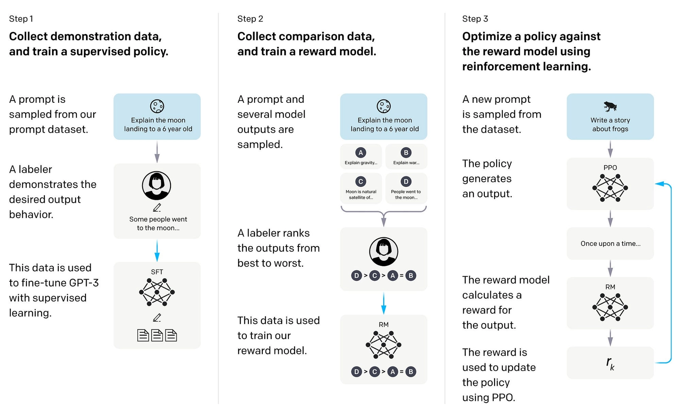
Supervised Fine-Tuning (SFT)
Adapt the pretrained model to specific tasks using labeled data.​
Methods:
Full fine-tuning​
Parameter-efficient tuning (e.g., LoRA)​
Applications:
Question Answering​
Text Classification​
Summarization
We will learn more SFT in lesson 5
[1]
[1] Walker II, Stephen M. "Supervised Fine-Tuning (SFT)." Klu, https://klu.ai/glossary/supervised-fine-tuning.

Slide 25
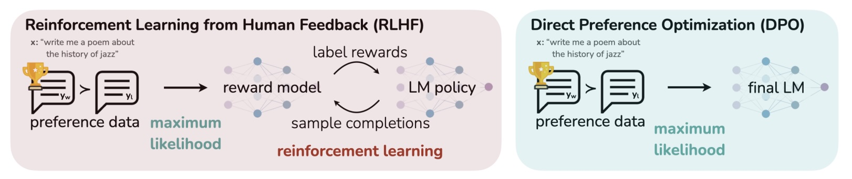
Alignment Techniques
Ensure model outputs align with human values and intentions.​
Methods:
DPO (Direct Preference Optimization):
Optimizes model outputs based on human preferences.
PPO (Proximal Policy Optimization):
Reinforcement learning approach to fine-tune models.
Importance:
Reduces harmful or biased outputs​
Improves user satisfaction
[1]
Emanuilov, Simeon. "Direct Preference Optimization (DPO) in Language Model Alignment." UnfoldAI, 23 Dec. 2024, https://unfoldai.com/dpo-llms/.

Slide 26
Direct Preference Optimization (DPO)
What is DPO?
A supervised learning method that aligns LLMs directly with human preferences.​
Simplifies the alignment process by eliminating the need for a separate reward model or complex reinforcement learning loops.
How It Works:
Utilizes datasets containing pairs of responses labeled as "preferred" and "less preferred."
Optimizes the model to increase the likelihood of generating preferred responses over less preferred ones.​
Benefits:
Simpler and more computationally efficient compared to traditional RLHF methods.​Demonstrated effectiveness in tasks like summarization and dialogue generation.​
Use Cases:
Training models like Zephyr and Intel’s NeuralChat.​
Aligning LLM outputs with specific human preferences in various applications.​

Slide 27
Proximal Policy Optimization (PPO)
What is PPO?
A reinforcement learning algorithm used to fine-tune LLMs based on human feedback.​
Forms the backbone of the Reinforcement Learning from Human Feedback (RLHF) approach.
How It Works:
Trains a reward model using human-labeled data indicating preferred responses.​
Fine-tunes the LLM by optimizing its policy to generate responses that maximize the reward signal, while ensuring stability through clipped updates.​
Benefits:
Provides robust alignment with human preferences across diverse tasks.​
Balances exploration and exploitation, leading to stable and efficient training.
Use Cases:
Fine-tuning models like OpenAI's ChatGPT.​
Enhancing LLM performance in complex, multi-turn dialogue systems

Slide 28

Training Data

Slide 29
Data Requirements – Scale and Diversity
Why Data Matters
LLMs learn by generalizing from massive datasets.
More data → better generalization (to a point), especially for multilingual and multi-domain tasks.
Example:
GPT-4: trained on an estimated 45+TB of text, including books, code, social media, academic data.
LLaMA 4: used 22T–40T tokens with high diversity across 200+ languages.
Key Requirements:
Scale: at least trillions of tokens to compete at frontier model level.
Diversity: includes web pages, code, academic papers, user queries, social chat, etc.
Quality: low-noise, well-formatted, human-like data improves alignment and reduces hallucination.

Slide 30
Training Costs – Real-World Examples
Infrastructure Costs
Hardware: Requires A100/H100 GPU clusters (or TPU equivalents)
Time: Full pretraining can take weeks to months
Model | Params | Tokens | GPU Hours | Cost Estimate
LLaMA 2 70B | 1.4T | 2.6T | ~1.5M | ~$3M–$4M
GPT-3 | 175B | ~300B | ~3M | ~$10M+
LLaMA 4 | MoE 400B | 22T–40T | 7.4M+ | ~$15M+

Slide 31
Data Collection Challenges
Challenges in Gathering Training Data
Low-Quality Web Content
Spam, clickbait, auto-generated junk
Example: Common Crawl requires heavy filtering
Duplicate Content
Repeated tokens bloat training without adding signal
Solution: MinHash or Exact Deduplication
Imbalanced Domains
Overrepresentation of English and tech leads to poor performance on underrepresented groups
Requires curation of minority languages, informal speech, and diverse domains
PII and Ethical Risks
Email addresses, SSNs, and user data often included in scraped corpora
Must apply regex filters + classifiers to remove sensitive information

Slide 32
Practical Considerations
What This Means for You
Smaller Teams → focus on data curation + fine-tuning, not full pretraining.
Use public or open datasets (e.g., The Pile, Wikipedia dumps, arXiv, Common Crawl + filters)
Lightweight options:
Start with open LLMs (Ollama, Mistral, LLaMA, Phi)
Train domain adapters (LoRA) with instruction or SFT data

Slide 33
Test-Time Scaling (O1, O3)
Optimizing model performance during inference by adjusting computational strategies without altering the model's weights.
O1 Optimization:
Utilizes mixed-precision training (e.g., FP16) to reduce memory usage and increase speed.​
Incorporates techniques like kernel fusion and hardware-specific quantization to boost performance.​
O3 Optimization:
Employs advanced methods such as sparse attention mechanisms and adaptive computation to handle complex tasks efficiently.​
Integrates reflection mechanisms, allowing models to self-assess and refine their outputs during inference.​
Benefits:
Enhanced reasoning capabilities.​
Reduced latency and computational costs.

Slide 34

Thank you

